Slide 1
IT Governance Generic Perspective
Governance is essentially about ensuring that business is conducted properly.
It is less about overt control and strict adherence to rules, and more about guidance and effective and equitable usage of resources to ensure sustainability of an organization's strategic objectives.

Slide 2
IT Governance
Guiding Principle
Framework
Governance Structure
Processes
Architecture Review Process
Standards Management Process
Roadmap Management Process
Implementation and Communication

Slide 3
Levels of Governance within an Enterprise
Architecture Governance typically does not operate in isolation, but within a hierarchy of governance structures
Corporate Governance
Technology Governance
IT Governance
Architecture Governance
Corporate governance is a broad topic, beyond the scope of an Enterprise Architecture framework
Technology governance controls how an organization utilizes technology in the research, development, and production of its goods and services.
IT governance institutionalizes best practices for planning, acquiring, implementing, and monitoring IT performance, to ensure that the enterprise's IT assets support its business objectives.

Slide 4
Governance Basic Principles
The following outlines the basic principles of corporate governance, as identified by the Organization for Economic Co-operation and Development (OECD)
Focus on the rights, roles, and equitable treatment of shareholders
Disclosure and transparency and the responsibilities of the board
Ensure:
Sound strategic guidance of the organization
Effective monitoring of management by the board
Board accountability for the company and to the shareholders
Board's responsibilities:
Reviewing and guiding corporate strategy
Setting and monitoring achievement of
management's performance objectives

Slide 5
Elements of Architecture Governance Strategy
A cross-organizational Tech Council must be established with the backing of top management to oversee the implementation of the Enterprise Architecture Governance strategy
A comprehensive set of Architecture Principles should be established, to guide, inform, and support the way in which an organization sets about fulfilling its mission through the use of IT
An Architecture Compliance strategy should be adopted - specific measures (more than just a statement of policy) to ensure compliance with the architecture, including Project Impact Assessments, a formal Architecture Compliance review process, and possibly including the involvement of the architecture team in product procurement

Slide 6
Architecture Compliance
Ensure compliance of individual projects with the Enterprise Architecture.
The IT governance function within an enterprise will normally define two complementary processes:
The Architecture function will be required to prepare a series of Project Architectures; i.e., project-specific views of the Enterprise Architecture that illustrate how the Enterprise Architecture impacts on the major projects within the organization
The IT Governance function will define a formal Architecture Compliance review process for reviewing the compliance of projects to the Enterprise Architecture

Slide 7
IT Governance Structure
Responsibility | Description | Objective | Key Players
Enterprise Design Tech Council | Director-level representation from engineering, product, business and architecture | Set enterprise level architecture vision and direction Set best practices, processes, strategy, leadership, guiding principles, reference architectures, and other architectural guardrails | Execs: Architecture Engineering: Tech Product: Business Product: PMO:
Domain Design Tech Council | Lead level representation from engineering, product, business and architecture | Architectural compliance at project level Reviews, consults, mentor project teams Communication to relevant stakeholders to ensure common understanding and smooth execution | Execs: Architecture Engineering: Tech Product: Business Product: PMO:
Program/Project Teams Tech Council | Engineering Teams / Solution Architect | Architectural compliance at project level Reviews, consults, mentor project teams Communication to relevant stakeholders to ensure common understanding and smooth execution | Execs: Architecture Engineering: Tech Product: Business Product: PMO:

Slide 8
IT Enterprise Design Review Council
Meeting | Freq. | Meeting Objectives | Attendees
Enterprise Design Meeting | Bi-Weekly (1 hour) – Beginning TBD | Set enterprise level architecture vision and direction Set best practices, processes, strategy, leadership, guiding principles, reference architectures, and other architectural guardrails | Execs: Architecture Engineering: Tech Product: Business Product: PMO:

Slide 9
DESIGN REVIEW / ENTEPRISE COUNCIL DETAIL
Enterprise Design Review Council
Purpose
Input
Meeting Details
Cadence Bi-Weekly
Administrator Program Office
Decision Body
Executive
Leads
Set enterprise level architecture vision and direction
Drive best practices, processes, strategy, leadership, guiding principles, reference architectures, and other architectural guardrails
Corporate & business unit strategies and major initiatives
Technology trends
Platform usage and feedback
Change to existing capabilities
Scope
Outcomes
Drive strategic vision, prioritization & roadmap for the e2e planning platform ecosystem
Platform delivery & roadmap
Decisions
Drive, advocate and hold the engineering teams accountable.

Slide 10
Domain Design Review Council
Meeting | Freq. | Meeting Objectives | Attendees
E2E Planning Domain Design Meeting | Weekly (1 hour) – Beginning TBD | Architectural compliance at project level Reviews, consults, mentor project teams Communication to relevant stakeholders to ensure common understanding and smooth execution Solution Architect for each platform make key decisions at high level and drive the platform design Platform team and engineering team understand integrated planning design and North Star What design deliverables to consider as part of backlog Determine architecture deliverable, engineering team deliverable | Execs: Architecture Engineering: Tech Product: Business Product: PMO:

Slide 11
IT Governance PLATFORM DESIGN REVIEW / DOMAIN DESIGN COUNCIL
DOMAIN DESIGN REVIEW COUNCIL
Purpose
Input
Meeting Details
Cadence Weekly or as needed
Administrator Enterprise Architecture
Council Members
TRIAD
Engineering Leads
TPM
Domain Architects
Architectural compliance at project level
Reviews, consults, mentor project teams
Communication to relevant stakeholders to ensure common understanding and smooth execution
Platform team and engineering team understand integrated planning design and North Star Architecture
Proposed changes to platform capabilities
Proposed platform alignment to e2e planning design
Scope
Outcomes
Review all new proposed platforms or platform capabilities (with intentional exclusions or limitations)
Align on Platform Assignment of new proposed technology solutions
Review proposed platform modifications and divestitures
Escalation to enterprise design council alignment or agreement is not achieved
changes to platform capabilities
Corresponding updates to enterprise architecture standards, artifacts and product roadmap
Determine architecture deliverable vs engineering team deliverable
Decisions
Agreement to proposed changes to platform capabilities or platform alignment to end to end platform design
Solution Architect for each platform make key decisions at high level and drive the platform design
Design deliverables to consider as part of backlog

Slide 12
Components of Enterprise Architecture Governance
Component | Description | Objective | Key Players
Architecture Review Process | Periodic review of solution at various points in technology delivery lifecycle Propose change to body of architecture standards | Ensure conformance to strategy and standards Identify exceptions Document Issues with enterprise impact | Execs: Architecture Engineering: Tech Product: Business Product: PMO:
Standards Management Process | Establish change control over architecture standards Track deficiencies and gaps in body of enterprise standards and work toward improvements Controlling the change process and communicating the impacts | Identify and document enterprise standards that need or present an opportunity for improvement Assigns accountability and responsibility for improving the standards Take input from and propose changes to technology and business components of enterprise roadmap Measure and report against changes to determine effectiveness | Execs: Architecture Engineering: Tech Product: Business Product: PMO:
Roadmap Management Process | Manage change against enterprise roadmap Prevent uncontrolled changes to roadmap | Define the roadmap Proposed investments, technology landscape, strategy and desired outcomes Document rules about how changes are made and who approves Set expectations and promote continued business and IT partnership through transparency | Business strategy and planning group Tech Product: Business Product: PMO:

Slide 13
Architecture Compliance Review Process
The review will be coordinated by the lead Enterprise Architect, who will assemble a team of business and technical domain experts for the review and compile the answers to the questions posed during the review into some form of report.
The questions will typically be posed during the review by the business and technical domain experts. Alternatively, the review might be led by a representative of an Architecture Board or some similar body with enterprise-wide responsibilities.

Slide 14
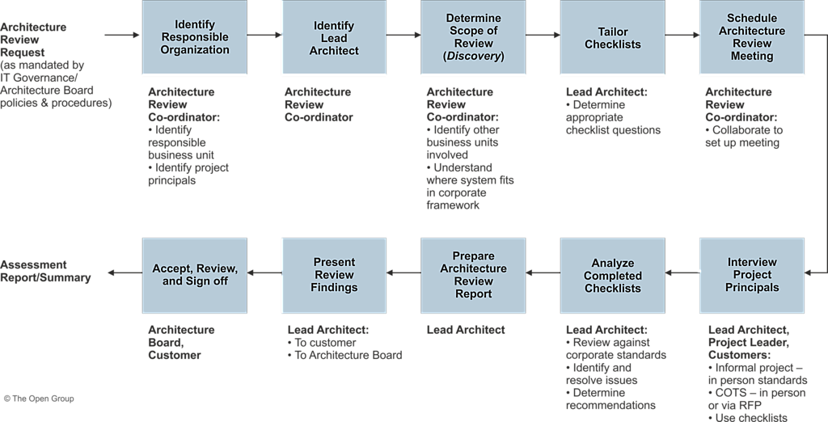
Architecture Compliance Review Process

Slide 15
Architecture Compliance Review Process
No. | Action | Notes | Who
1 | Request architecture review. | As mandated by IT governance policies and procedures. | Anyone, whether IT or business-oriented, with an interest in or responsibility for the business area affected
2 | Identify responsible part of organization and relevant project principals. |  | Architecture Review Co-ordinator
3 | Identify Lead Enterprise Architect and other architects. |  | Architecture Review Co-ordinator
4 | Determine scope of review. | Identify which other business units/departments are involved. Understand where the system fits in the corporate architecture framework. | Architecture Review Coordinator
5 | Tailor checklists. | To address the business requirements. | Lead Enterprise Architect
6 | Schedule Architecture Review Meeting. |  | Architecture Review Co-ordinator with collaboration of Lead Enterprise Architect
7 | Interview project principals. | To get background and technical information: For internal project: in person For COTS: in person or via RFP Use checklists. | Lead Enterprise Architect and/or Architect, Project Leader, and Customers
8 | Analyze completed checklists. | Review against corporate standards. Identify and resolve issues. Determine recommendations. | Lead Enterprise Architect
9 | Prepare Architecture Compliance review report. | May involve supporting staff. | Lead Enterprise Architect
10 | Present review findings. | To Customer To Architecture Board | Lead Enterprise Architect
11 | Accept review and sign off. |  | Architecture Board and Customer
12 | Send assessment report/summary to Architecture Review Coordinator. |  | Lead Enterprise Architect

Slide 16
Architecture Compliance Review Process
No. | Role | Responsibilities | Notes
1 | Architecture Board | To ensure that IT architectures are consistent and support overall business needs. | Sponsor and monitor architecture activities.
2 | Project Leader (or Project Board) | Responsible for the whole project.
3 | Architecture Review Co-ordinator | To administer the whole architecture development and review process. | More likely to be business-oriented than technology-oriented.
4 | Lead Enterprise Architect | To ensure that the architecture is technically coherent and future-proof. | An IT architecture specialist.
5 | Architect | One of the Lead Enterprise Architect's technical assistants.
6 | Customer | To ensure that business requirements are clearly expressed and understood. | Manages that part of the organization that will depend on the success of the IT described in the architecture.
7 | Business Domain Expert | To ensure that the processes to satisfy the business requirements are justified and understood. | Knows how the business domain operates; may also be the customer.
8 | Project Principals | To ensure that the architects have a sufficiently detailed understanding of the customer department's processes. They can provide input to the business domain expert or to the architects. | Members of the customer's organization who have input to the business requirements that the architecture is to address.

Slide 17
IT Governance Operating Model Implementation
 | Description | Objective | Key Players
1 | The framework reviewed and approved by organizational entities and stakeholders involved in and impacted by EA program | Defining, Reviewing, fine-tuning and approve the framework | Execs: Architecture Engineering: Tech Product: Business Product: PMO:
2 | Develop how-to details of EA governance | Introduction of new standard or standard update Prioritization process and criteria for inclusion of IT projects in the Transition plan IT projects impact analysis Alignment of IT projects with EA at SDLC milestones Waiver requests for non-compliance IT standards with EA | Execs: Architecture Engineering: Tech Product: Business Product: PMO:
3 | EA governance implementation plan | EA governance implementation plan is written that will expand on the EA governance framework Implementation of EA governance is responsibility of EA program manager or Chief Architect The first step in implementing EA governance process is reviewing, fine-tuning and approving the EA governance framework. Once the framework has been finalized and approved, the supporting EA governance procedures will need to be developed and communicated to all parties involved. | Execs: Architecture Engineering: Tech Product: Business Product: PMO:

